Slide 1

Chapter 4 & 5
Programming with R & Exploratory Data Analysis and Graphics –
Statistics Using R with Biological Examples (Seefeld)
Matthew Wayne Valentine
Office 1.32
Lab K2 – Tech Room K2
mvalentine@uwc.ac.za

Slide 2


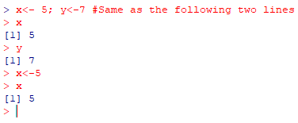
Syntax
When it comes to syntax R one can write many assignments within one line of code as well as comments as long as those assignments are separated by semi-colons and the comments starting of with a #.
When using arithmetic operators, the usual mathematical rules apply.
Notes:
x<- 5; y<- 7
x
y

Slide 3
Logical and Relational Operators
Logical and relational operators are used when you want to selectively execute code based on certain conditions. The table below provides you with commonly used logical and relational operators.
Operator | Functionality
& | And
| | Or
! | Not
== | Equal to
!= | Not equal to
< | Less than
> | Greater than
<= | Less than or equal to
>= | Greater than or equal to

Slide 4
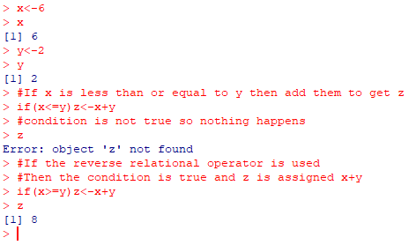
Logical and Relational Operators – If and Else
There are usually logical and relational operators that are used with conditional programming statements if and else.
The syntax of the if and else statement is written as follows;
if (condition is true)
then do this
The condition that’s needs to be met is allows written in Parentheses which will contain a relational operator to determine if the condition is TRUE or FALSE.
Notes:
x<- 6
x
y<- 2
y
if(x<=y) z<- x + y
z
if(x>=y) z<- x + y
z

Slide 5
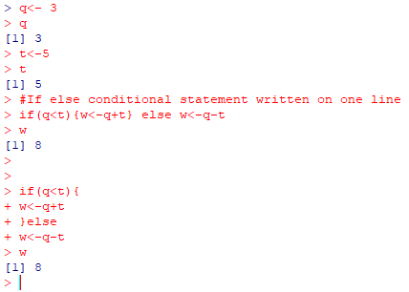
Logical and Relational Operators – Then
In order to get something if the condition in the parentheses is not TRUE, then one would use If in conjunction with Else to specify an alternative.
The following syntax should be used in this case the code following Else will execute as long as the If condition is not TRUE.
if (condition is true)
then do this
else
do this
These curly brackets are frequently used to block sections of code, and will indicate code continues on the next line.
Notes:
q<- 3
q
t<- 5
t
if(q<t){w<- q+ t} else w<- q - t
w

Slide 6

Looping - While
Looping is a form of controlled repetition in which can efficiently repeat code without having to write the same code over and over again. There are two types of looping while and for statements.
The syntax for the While statement are as follows;
while (condition controlling flow is true)
perform task
For example suppose we want to execute adding 1 to the variable x while x<=5: Why would this call return an x value of 6?
Notes:
x<- 0
x
while(x<=5) {x<- x + 1}
x

Slide 7
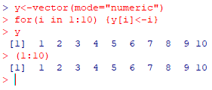
Looping - For
The syntax for the For statement are as follows;
for (i in start:finish)
execute task
As an example, if you want to initialize a vector with values you can loop through it to assign the values:
Notes:
for(i in 1:10) {y[i]<- i}
y
for(i in 1:10) {y[i]<- i+2}
y

Slide 8
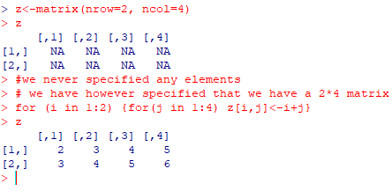
Looping – Matrices with Loops
For loops can also Be nested (One inside the other) to initialize matrices or perform similar tasks:
Notes:
z<- matrix(nrow = 2, ncol = 4)
z
for(i in 1:2) {for(j in 1:4) z[i,j]<- i + j}
z

Slide 9
Some basic existing functions
Function | Operation Performed
sqrt(x) | Square root of x
abs(x) | Absolute value
sin(x), tan(x), cos(x) | Trigonometric functions
exp(x) | Exponential
log(x) | Natural Logarithmic
log10(x) | Base 10 Logarithmic
ceiling(x) | Closest integer not less than x
floor(x) | Closest integer not greater than x
round(x) | Closest integer to the element

Slide 10
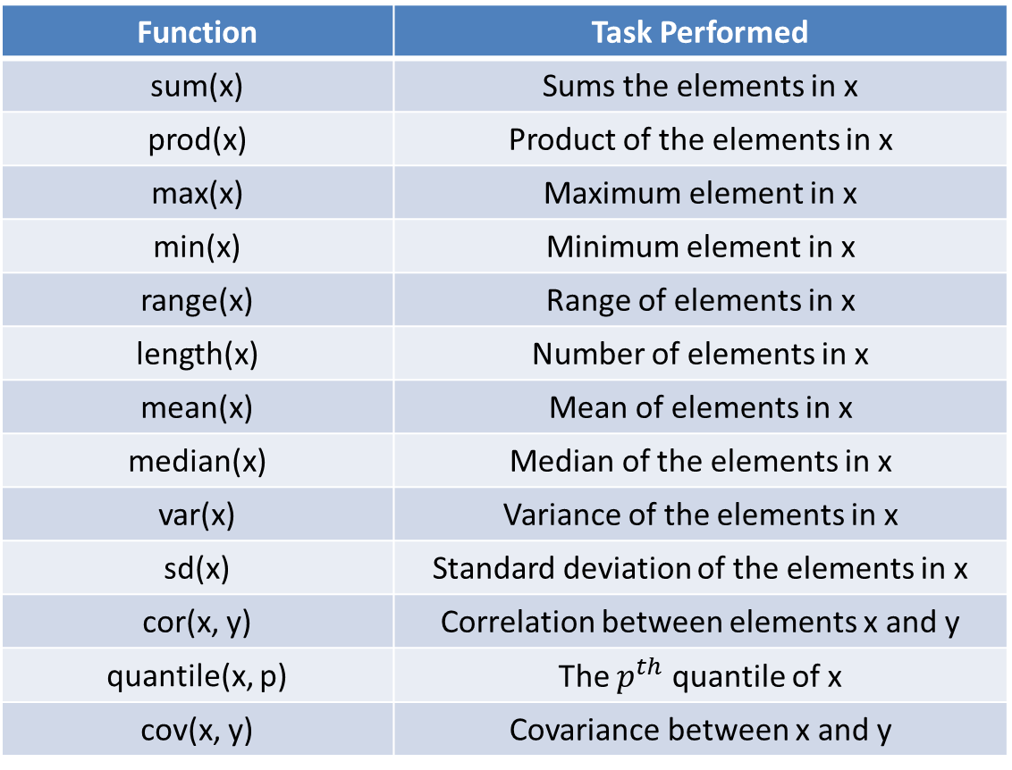
Summary functions
Function | Task Performed
sum(x) | Sums the elements in x
prod(x) | Product of the elements in x
max(x) | Maximum element in x
min(x) | Minimum element in x
range(x) | Range of elements in x
length(x) | Number of elements in x
mean(x) | Mean of elements in x
median(x) | Median of the elements in x
var(x) | Variance of the elements in x
sd(x) | Standard deviation of the elements in x
cor(x, y) | Correlation between elements x and y
quantile(x, p) | The $p^{th}$ quantile of x
cov(x, y) | Covariance between x and y

Slide 11

The Summary function
The summary() function in R will return the min, 1st quartile, median, mean, 3rd quartile and maximum values of the element in the argument.

Slide 12
Study
Chapter 4 & 5
Programming with R & Exploratory Data Analysis and Graphics –
Statistics Using R with Biological Examples (Seefeld)
Matthew Wayne Valentine
Office 1.32
Lab K2 – Tech Room K2
mvalentine@uwc.ac.za

